Slide 1
Concurrency: Reactive vs Shared State
Benchmarking Akka actors against shared-state concurrency

Slide 2

About Me
Developer
Rock climber
Dad
Scala junky

Slide 3



HBC Digital
The company I work for
Four E-commerce banners
NOT an agency
Strong engineering culture
Incredible stacks
Scala/Play/Akka/Mongo
Node/React/Ember

Slide 4
Concurrency
Multiple threads executing simultaneously
Our example- an inventory web service with multiple clients making requests in parallel
Challenge- ensure that we don’t sell inventory we don’t have

Slide 5
Options to Handle Concurrency
Shared-State
Akka (Reactive)
Other:
Function Reactive Programming (Not the same as Reactive)
Publisher/Subscriber

Slide 6
Shared-State
Shares mutable state across threads
Uses locks to prevent race conditions
Pros
Heavily used
Simple to reason about for trivial applications
Cons
Thread sleep/awake is expensive
Complex applications are very difficult to model
Deadlocks!

Slide 7
Akka (Reactive)
Actors instead of threads- lightweight, easy to reason about
Actors communicate with message passing
Messages are objects containing information
Not imperative, they provide information and are REACTED to by the actor.
Ex “Someone requested 5 shirts”, not “Give me 5 shirts”
Mutable state- But only an actor can change itself
Each actor has a mailbox (queue)- synchronous message processing
Pros
No locks! So no thread sleep
Ability to use pools for actions that don’t modify state
Completely non-blocking communication between actors
Modeling mimics real life: actor has one job and does one task at a time
Delegation- delegate tasks to children to allow for concurrent processing, fault tolerance, etc
Supervision- parent handles faults in child (can restart, stop, resume, etc)
Very loose coupling, messages are strongly typed, end points aren’t
Functional: new functions are new actors so robust and easy to test

Slide 8
Akka (Can you tell we like this?)
Cons
Design is extremely important
Resiliency, parallel processing, and supervision depend on it
Lack of typing for actor receive method
A message can be any object- scary for Java guys
Single threading for mutable state
Sharding, not multiple writers

Slide 9
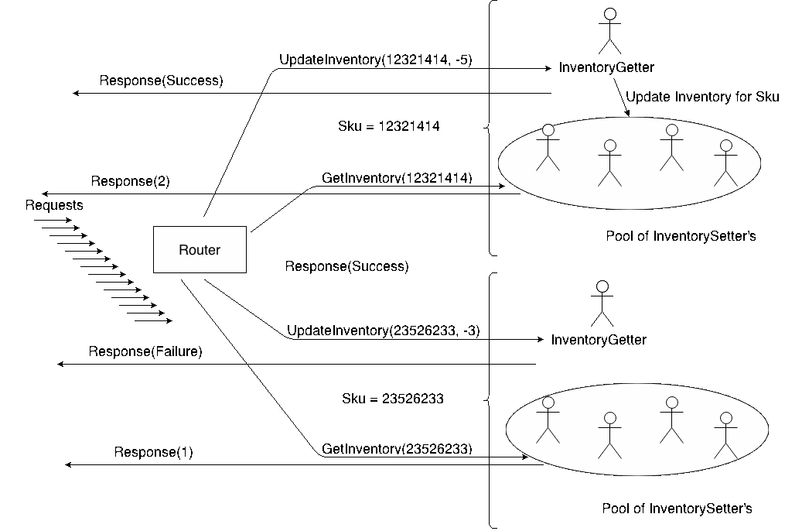
A diagram to explain

Slide 10
Other Concurrency Strategies
Functional Reactive Programming
Instead of messages or events, a signal is passed which represents a value over time.
Signals are aggregated to form new signals
Con: Not good for two way communication or state which can be concurrently modified
Publisher/Subscriber
Javascript event handling for example
Listeners register a handler with an event source
Cons
Forces imperative style
Concurrency gets very complicated (callback hell)
Tightly coupled code

Slide 11
More Akka Information(!!!)
Extremely High Performance:
50 million messages/second on a single machine
Small Memory Footprint:
2.5 million actors per GB of heap
Hierarchical:
All actors have parents and 0-n children
Extended by powerful frameworks
Spray (Rest), Play (Web apps), Slick (DB), Streams

Slide 12
A Quick Dev Ops Slide
HBC is very focused on Dev Ops
Developers are empowered to work with Infrastructure to create dev environments that can move all the way to Production
We are using
Kitchen (testing)
Vagrant (virtual machines)
Puppet (provisioning)
Librarian Puppet (more provisioning)
Docker (containers)
This allows us to treat infrastructure as code- versioning, pull requests, code review, regression testing, reproducibility
For this project I started with a Linux base box
I used Puppet Librarian to source modules for SBT, Java, MongoSB, and Docker
Then I used Puppet to install those modules in my base box (provision).
Finally, I used Puppet to spin up and deploy a Docker container running StatsD and Graphite.
At the end of all this I could run my Play applications with SBT and Java and I had running MongoDB, StatsD, and Graphite instances ready to use.

Slide 13
Okay enough slides
Let’s look at and run some code!

Slide 14
Questions
??????

Slide 15
Obligatory We Are Hiring Slide
Surprise! We are hiring.
@HBCDigital
dana_peele@s5a.com
@Dana_S_Peele
Repo for the demo and slideshow:
https://github.com/saksdirect/react-vs-shared-state-inventory

